Slide 1
Branches

Slide 2
So far, all the examples we’ve talked about have involved two people. It is apparent how messy things can become between just two collaborators, let alone ten.
main
Alice and Bob have been working on their project: Alice is programming and Bob is texturing. There isn’t much overlap in their jobs so they have managed to get along so far without major headaches.
Now let’s add Carol, Dave, and Eve.
There are two main considerations. There will be an increase in the complexity of merge conflicts as the project grows, and bugs and problems will propagate to everyone else with no safeguards.
Eve is responsible for the main character. Alice, Bob, Carol and Dave all have an overlap with her role. They will have to edit files that Eve also needs to edit.
This might lead to a situation where Alice, Bob, Carol and Dave have all pushed commits without issues while Eve was working. Now, Eve pulls their changes, and suddenly there are many files which conflict with hers and hours of work for her to sort through.
Let’s make this example more contrived. Eve finishes her marathon conflict merge, but now her merges introduced a bug that breaks systems that all four of the others are involved with.
Do they bin Eve’s hours of fixing? Do they spend hours fixing themselves? Do they roll back to a point the bug didn’t exist and force everyone to lose work?
?
Alice
Bob
Carol
Dave
Eve

Slide 3
This team needs branches. In a nutshell, when a branch is made, it copies the current state of its parent branch. From here on out, changes made to the new branch will not affect the parent branch.
level
main
camera
Let’s take an example. Alice and Bob are tasked with making a camera system, and Carol and Dave are tasked with building a level. Alice and Bob implement a basic working camera for Carol and Dave to use for now, and Carol and Dave construct a simple blockout for Alice and Bob to run around in.
1
2
3
3
Alice and Bob branch from main. Now they are on a new branch called main/camera.
4
4
Carol and Dave branch from main. Now they are on a new branch called main/level.
This means that Alice and Bob can build the camera without fear of bugs affecting Carol and Dave. This also means that Alice and Bob can mess with Carol and Dave’s blockout, if they need to test some scenarios, without affecting Carol and Dave’s level.
Carol and Dave can build the level without disrupting Alice and Bob’s camera work. They can even tweak the camera if they need to see the environment better without affecting Alice and Bob.
Dave
Carol
Bob
Alice

Slide 4
Alice and Bob have finished their camera. How do Carol and Dave (and any other branches) get their camera?
level
main
camera
Branches can be merged or rebased in much the same way as your local branch is merged and rebased with the remote branch.
1
Alice and Bob merge their camera branch with the main branch. There aren’t any conflicts, as no one has touched the main branch since they split off.
2
3
3
3
Now, the main branch has the entire commit history of their branch (and the current state of their branch).
4
4
4
Carol and Dave aren’t finished with their level yet, but they can get Alice and Bob’s changes. They can rebase their branch onto main to get the finished camera feature from behind.
5
There is a conflict, though. Alice and Bob changed the blockout since Carol and Dave branched from main. So at each commit stage, they discard Alice and Bob’s level file. Since they know that there is no valuable work in Alice and Bob’s level file, they can resolve the conflicts without any effort.
6
6
7
It should be mentioned that when Alice and Bob merged, their branch didn’t disappear. If they want to implement new camera feature, they can carry on committing on the camera branch. Carol and Dave can rebase again after Alice and Bob merge.
Dave
Carol
Bob
Alice

Slide 5
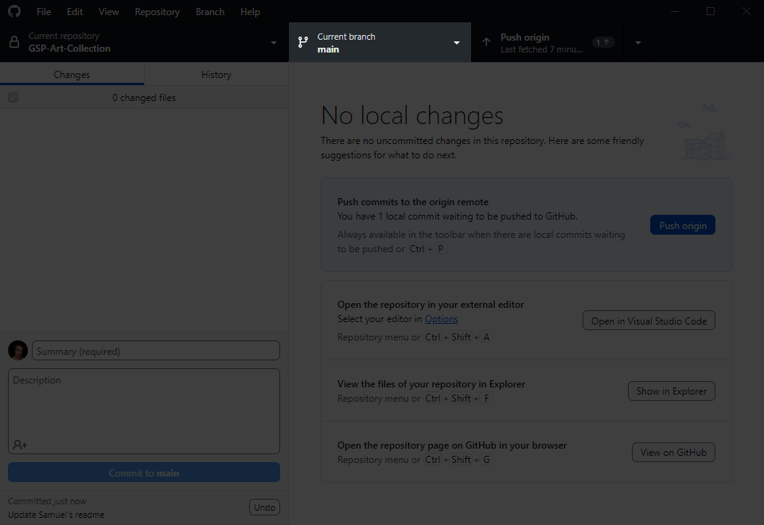
CHECKOUT BRANCH
Alice and Bob want to see their camera in action. The good news is, they’re not tied to main/camera. Instead of complicating things by rebasing, they can simply use their GitHub client to checkout the main/level branch. Their working directory will switch to Carol and Dave’s (and theirs will be preserved on the remote repository).
You can change the branch you are on very simply.
This is a powerful feature and your entire folder will change to the latest commit on the branch you switch to. You should only do this if you have no local changes. If you have unpushed commits, Git will preserve them in your local repository until you return to that branch, but switching branches will not push your local changes/commits for you.

Slide 6
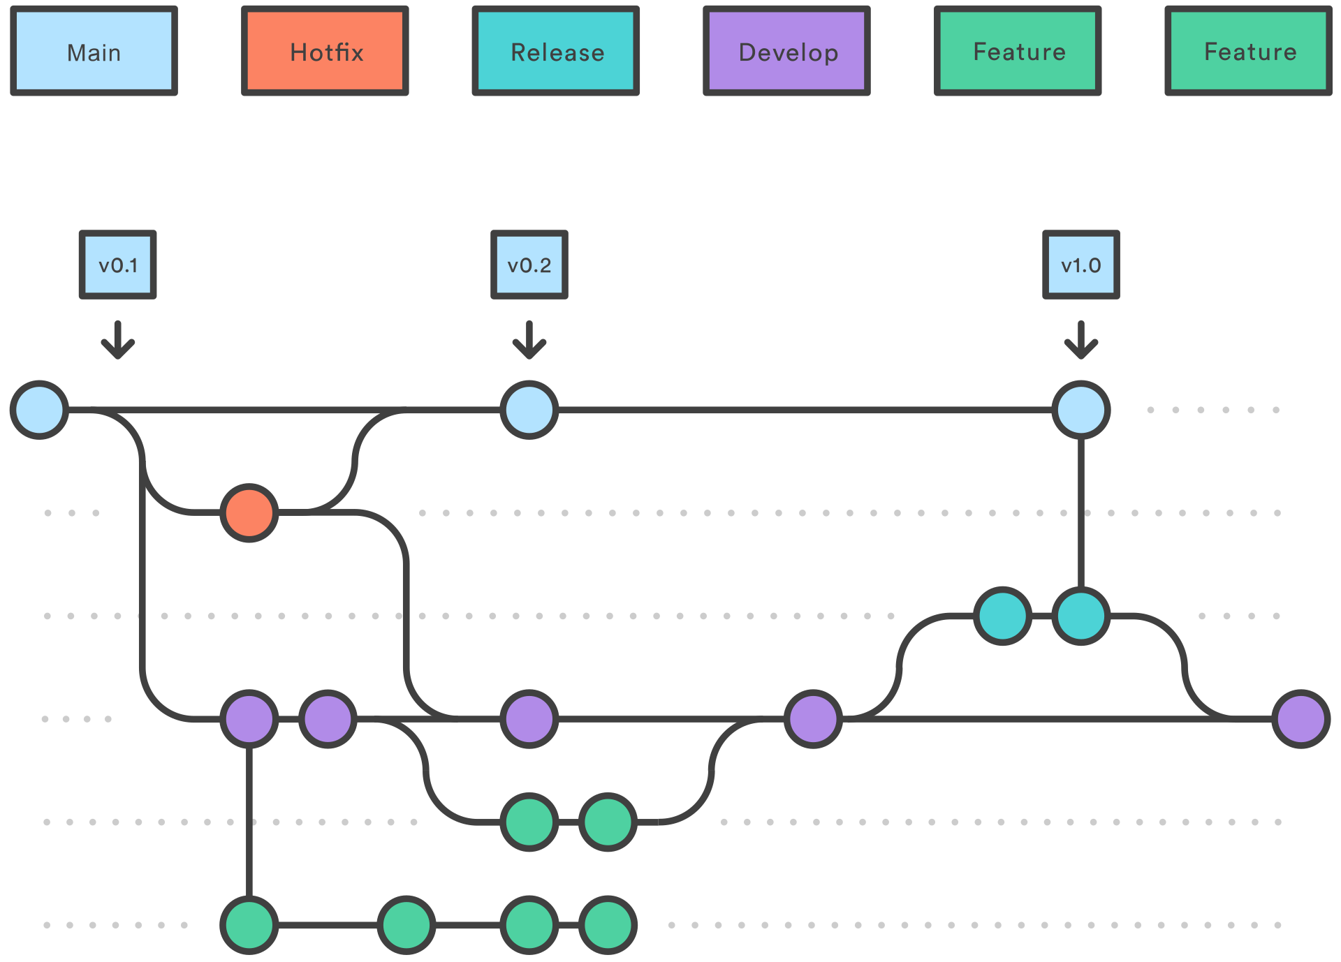
GITFLOW BRANCH STRATEGY
This is a diagram of the Gitflow branch strategy. It was once the predominant branch strategy, but it isn’t used as much anymore. This isn’t because it’s necessarily bad: it’s due to continuous integration of development and live service (think how apps like Instagram update almost every day).
However, Gitflow is still very suitable for projects that are scheduled and due to complete at a (somewhat) distant time in the future.
Follow the link if you want some additional information.
Please ignore their bias against this workflow. It is a good explanation of Gitflow, but they sell live-service software development tools, so they would actively not want their consumers to think this is a good solution for them. We aren’t going anywhere near live-service.
Gitflow Workflow | Atlassian Git Tutorial

Slide 7
This is a proposal of our branch strategy, and where everyone’s “home branch”, where you will push your work, might be.
As mentioned, you are not glued to one branch. It is easy to change between them to see what is going on elsewhere, to see your features in action on prod, and to help with QA testing, or to come to the rescue of someone in need of help with their asset.
Probably Drew will have to spend their time split between characters and assets! I have also not put boss anywhere; I thought probably he will want/need to switch between most branches.
Let’s discuss this to make sure everyone is happy with it.
main
Main branch should always compile a stable, tested game version: alpha -> beta -> gold
qa
No chores or features should be done on QA branch: everything’s pulled in when testing needs to start
prod
Production branch: assets/features are pulled together, level built/implemented, compile this branch for “live version”
Ren
Rui
feature
Feature branch for programming and implementing features concurrently (there’s often several child branches)
Josh F
Samuel
chars
Character branch that branches from feature; programming features are required to make characters function
Lottie
Roman
Drew
asset
Assets can be built and perfected in isolation from the the other development and each pulled when ready
Jovi
Sef

Slide 8

Cycle repeats for beta and for submission; except when qa begins for submission, development winds down
Reach alpha; production still continuing
Current development is pulled into qa, to begin testing a rough alpha: “wherever we’re at”
Project begins; blank Unity project is ready
Production is underway on all development branches
Finished features and assets are pulled into prod branch, level building continues (many times)
Alpha version is tested; production continues; work toward beta
Project initiation
QA for Alpha
QA for Beta
QA for Sub
Alpha
Beta
Sub
main
qa
prod
feature
chars
asset
This is not a timeline or a perfectly accurate blueprint. It’s a representation to help everyone understand how to work.

Slide 9
When you look at it from a top down perspective like this, it can be insightful to see how everything is pulled together with minimal conflict, but it can also be overwhelming or confusing. So, it is also beneficial to think about how this will work in practice from one person’s perspective, and what are the benefits.
[branch]
You and your branch collaborator(s) can work to add one feature at a time.
For feature/asset creators, your finished features can be pulled into production without you having to do anything, while you continue to work.
For people working on the production branch, you can have the finished features and assets pulled in without doing anything, while you continue to work.
For feature/asset creators, don’t have to stop working while QA and testing is ongoing. You can review bug reports or issues related to your work and implement them when time allows.
For production/qa, you can log bugs and issues and have them fixed by the time changes are next pulled in, without fixing them yourself.

Slide 10
ASSET FOLDER STRUCTURE
All of the heavy cache files are configured to be ignored by the repo. That means when you change and push, only your work is pushed, not your cache files.
Unity assets cannot have spaces in their filepath/filename.
Please do not commit changes to the repo from the wrong branch. If you are working on the assets branch, please do not edit the scenes, and if you are working on the production branch, please do not edit the models, etc.
Any changes you make in this way could be overwritten or undone! And probably unintentionally! If there is a bug or a glitch and it’s not your area, tell the responsible person, so that they can fix it. Please don’t try and edit it, you will create a merge conflict.
There is a WIP folder for anything you want to copy out and test a change that’s out of the scope of your branch. Our repository is configured to ignore any files in the WIP folder. Experiment away.
And finally, please do not store anything that is not a Unity asset. We have to be conservative with storage. Use the art repo or your WIP folder.
Rendering
Settings
Audio
Music
Ambient
Samples
Scripts
Library
Editor
Architecture
GameObjects
ScriptableObjects
Strings
Prefabs
UI
Components
Managers
Controllers
GameObjects
Scenery
Props
Characters
Effects
Animators
Models
Scenery
Meshes
Materials
Textures
Props
Meshes
Materials
Textures
Characters
Meshes
Materials
Textures
Scenes
WIP
We need to agree on this so everyone is happy.

Slide 11
Tracking

Slide 12
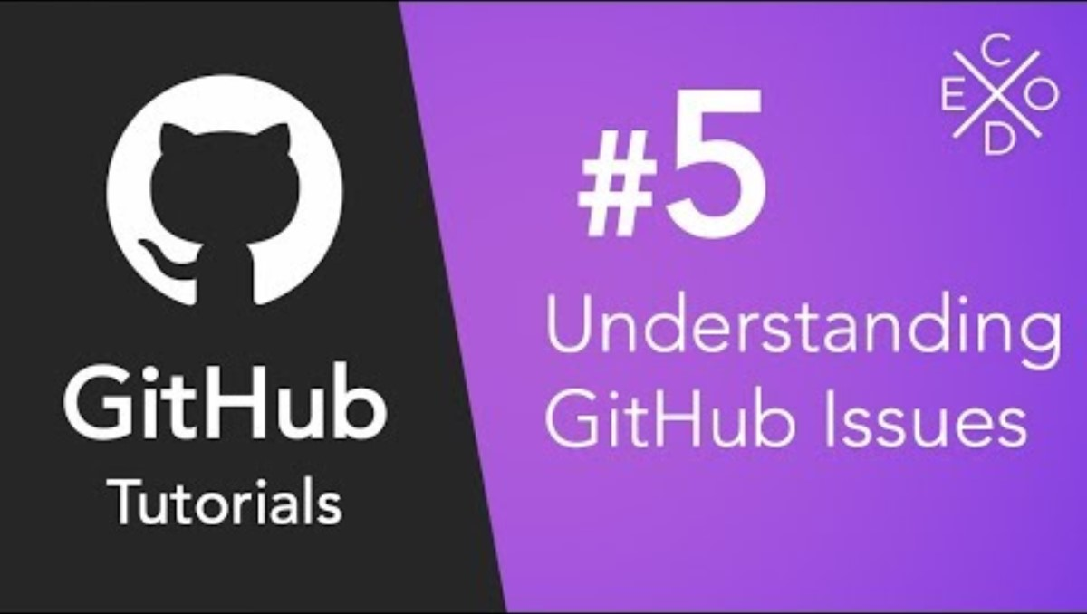
CHECKOUT BRANCH
Please watch this (relatively helpful) video to understand the tracking of bugs and issues on the GitHub website.
When you assign issues please do not assign them to individuals; someone might get landed with more than their fair share of work. Please assign them to teams like “programmers”, “prop artists” etc.
When you are working on fixing a logged issue, please use the methods in this video to link your commits that fix things with the issue they are fixing.

